Slide 1

System Lifecycle
And SSMS Protocol
Edwin Ramos, Jay Mistry, Bing Gao, Michael Chang, Carlos Salinas, Akashdeep Singh, Diyor Zoirov

Slide 2
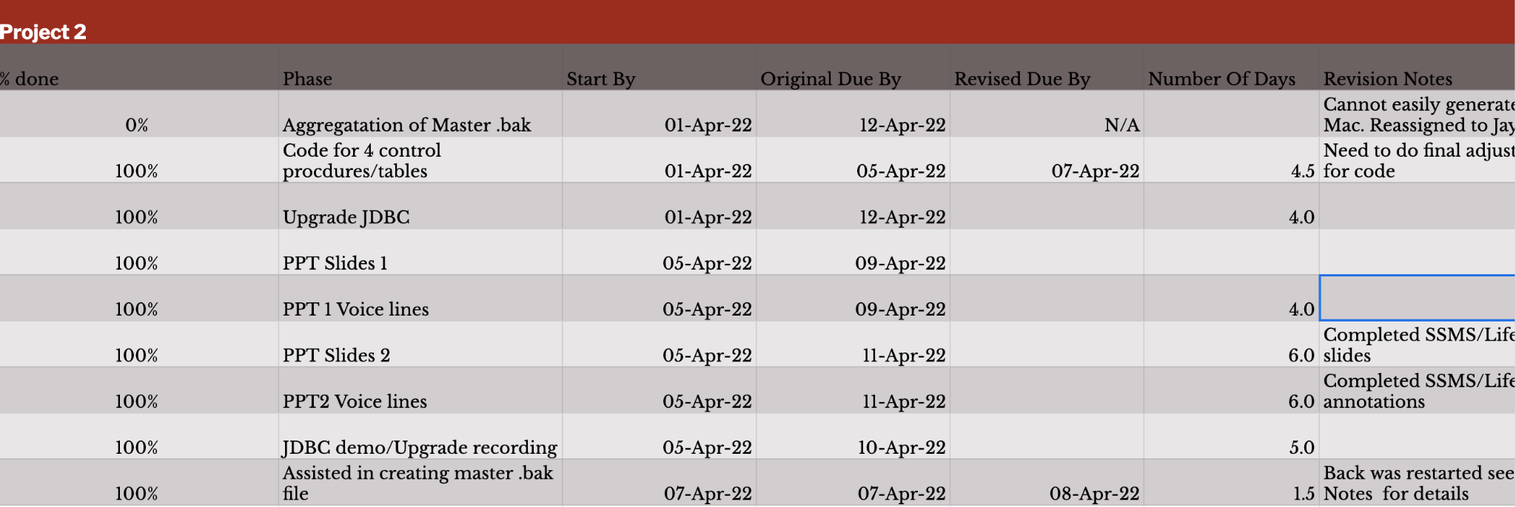
To-Do List

Slide 3
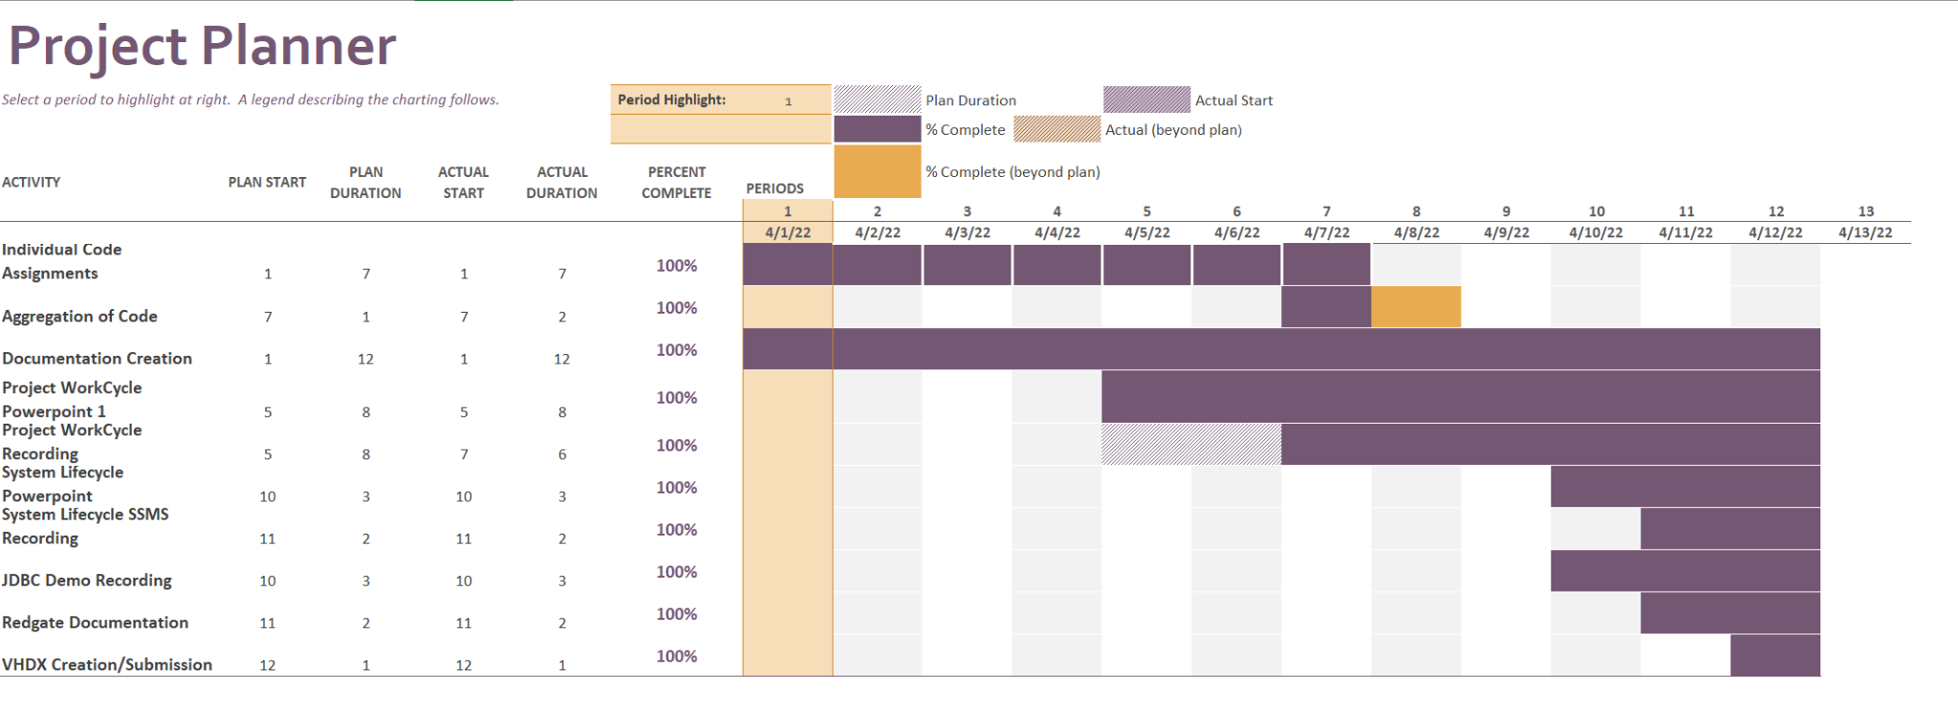
Project Planner

Slide 4
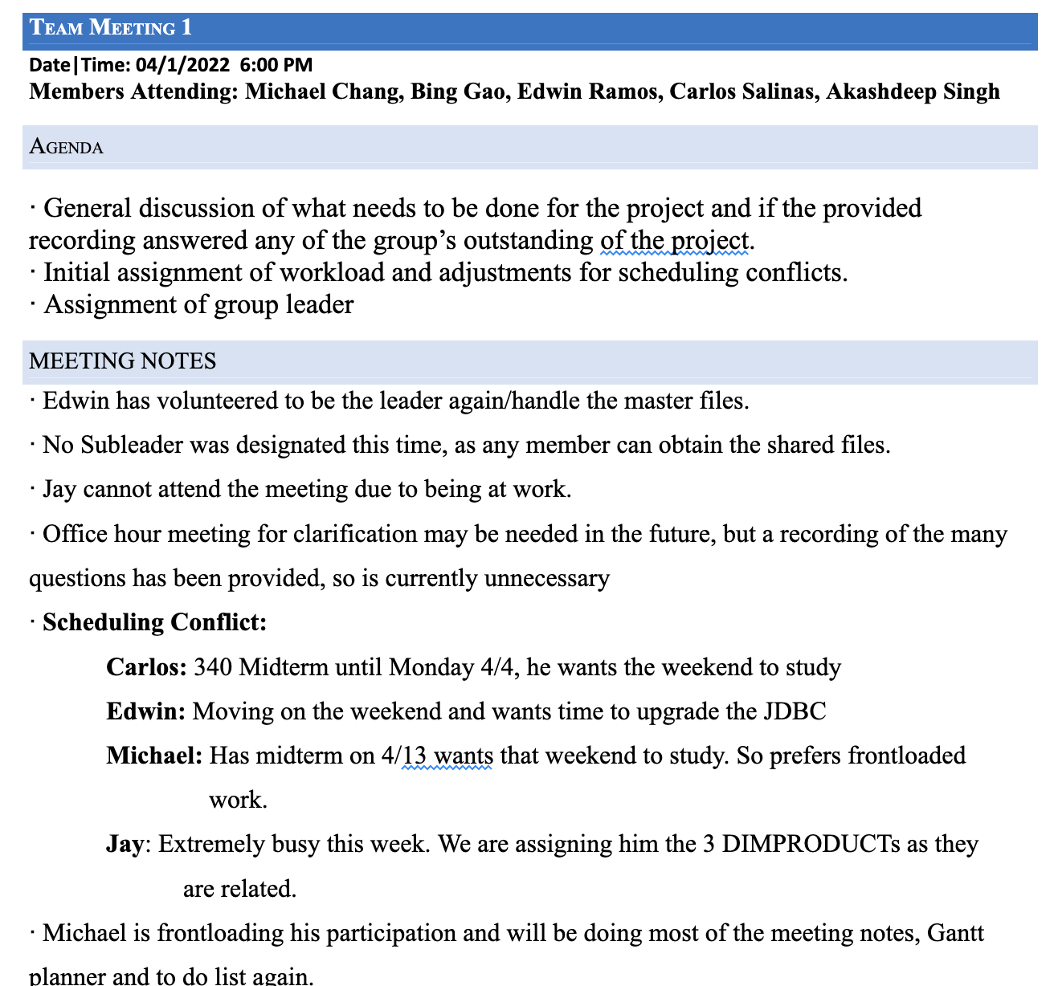
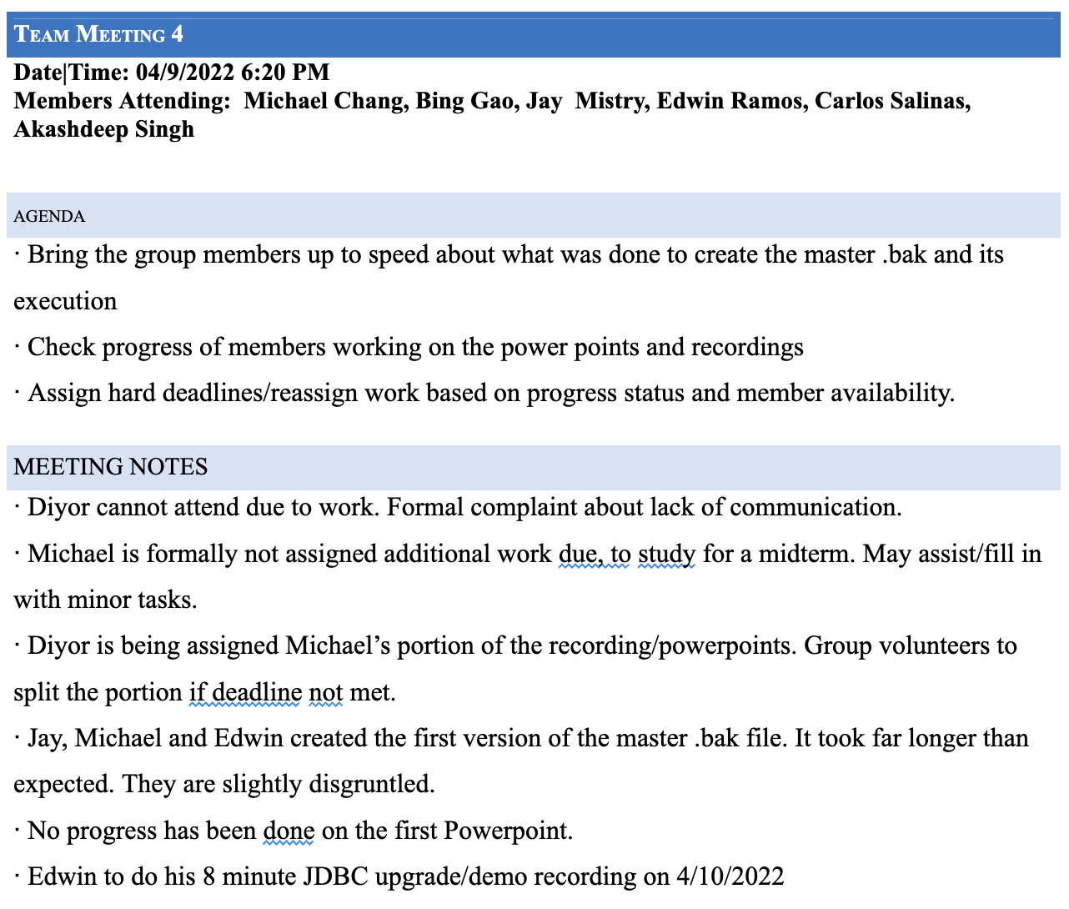
Meeting Notes

Slide 5
SSMS Lifecycle
Planning: To-do, Gantt, and Meeting Notes
Analysis: Go over stored procedures and how to make it work on JDBC
Design: To develop the stored procedures
Implementation: Create views for stored procedures and implement the workflow steps
Maintenance: Develop a final master that all our group members can run and load the Star Schema

Slide 6
Planning
Understand the project specifications
Create the project work to taking attendance, minutes and action items for each member(To Do List, Gantt Planner and Meeting Notes)
Initial assignment of workload and divided work for each member
The project leader determine the foundation for the project
Team members start to create individual stored procedures
Consolidate members’ procedures and debugging

Slide 7
Analysis
Identify what stored procedures to complete
Emphasize how exactly the workflow steps will be integrated to each one of the stored procedures
Have code adhere to guidelines
Have master run the final Star Schema and send it out to the other group members
Run the Star Schema in the JDBC and break it down in an 8 minute video

Slide 8
Design
Developed the individual stored procedures
Set up the variables, parameters and attributes for each procedure
Create a view when executed a procedure to ensured each procedure works correctly

Slide 9
Implementation
Execute each procedure in SSMS individually
Observed the result of execute each procedure, test it for running errors.
Observed the view which created by procedure, confirm that the data is correct
Observed the WorkFlowSteps to ensure it records each stored procedure operating
Used Truncate procedure to clear table data when required

Slide 10
Maintenance
Fix the syntactical and logical errors in master before distributing a version of our final BIClass database
Check the process for adding and dropping foreign keys works
Create and load the LoadStarSchemaData and check if the view table works
Delete our executables/truncates towards the end
Send out revised final version of master

